Slide 1

Gender Identity and Discrimination in the Rental Housing Market: An Experiment Based in Kolkata, India
1

Slide 2
Group Members
MOHAMMAD MASOOD RAZA C93/ECO/211116
ERAM FEROZ C93/ECO/211089
SAMIUL GAZI C93/ECO/211163
IESHA TANDON C93/ECO/211095
AHANA PAL C93/ECO/211020
SHRESTHA ROY C93/ECO/211187
ANISH MAJHI C93/ECO/211033
BANASHREE SARKAR C93/ECO/211066
TIYASA DAW C93/ECO/211256
IFRAH ARFEEN C93/ECO/211096
SOUVIK SARKAR C93/ECO/211216
DOLLY ROY C93/ECO/211088
SURAJIT PAUL C93/ECO/211240
ANAM JAWED C93/ECO/211026
DIVYA CHARAN C93/ECO/211087
ANIKET DAS C93/ECO/211031
SIMRAN AGARWAL C93/ECO/211197
BAPAN BISWAS C93/ECO/211067

Slide 3


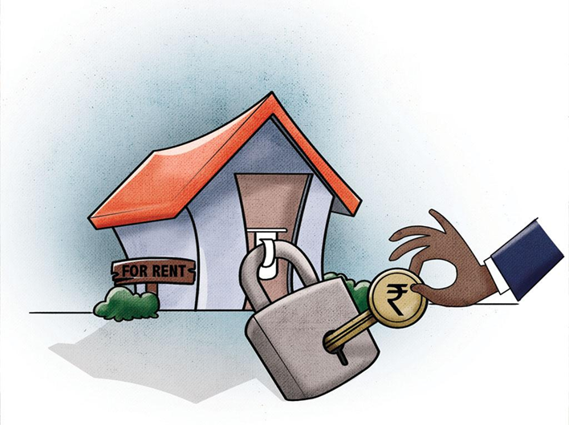



What is discrimination?
Discrimination lies in the recognition that individuals are treated differently because of the perceived characteristics of a group with which they are identified rather than their individual capabilities (Ruwanpura,2008)
Individuals’ social attributes such as class, race, gender, ethnicity, religion, caste, nationality, disability, age, and many other characteristics; are the bases of discrimination. (E.g. Murchie and Pang ,2018)
Discriminatory experiences are faced by individuals in various places like labour market(E.g. Bertrand and Mullainathan,2003), rental market(E.g. Carpusor & Loges ,2006) , education (Govindasamy,2003), vocational training (Imdorf,2017), media(Haraldsson,2021) etc.
Theories of Discrimination
1. Statistical Discrimination: Discrimination arising from the profit motivated behavior of an individual while facing uncertainties accompanying selection decisions.
(Phelps, 1972 and Arrow, 1973)
Simple Discrimination: Purely on a simple Ground
Multiple Discrimination: Different grounds at different point of time
(Makkonen, 2002)
Types Of Discrimination
Theories of discrimination
Types of discrimination
Intersectional Discrimination: Multiple grounds at a particular point of time
Compound Discrimination: Several Grounds accumulate
2. Taste Based Discrimination: an individual’s prejudice based discrimination, governs the idea of Taste Based Discrimination. (Becker,1957)
4
3
2

Slide 4
Literature Review

Slide 5
Studies based on discrimination in the Rental Housing Market
Studies | Basic Findings and Proposition
Flage,2018 (OECD) | Ethnic and Gender discrimination does exist, favourable towards females
Acolin et al. ,2016; Flage,2018; Auspurg et al. ,2017 (USA) | -Blacks are discriminated in the rental housing market, consistent with previous studies -Females received more responses than males applicants when it came to Arab. Implying gender discrimination in the case of Arabs. -Muslim was a negative signal, Christians received favorable response rates -In the highest rent category, landlords favored the Arab-sounding name -Discrimination goes away when e-mail inquiries use a high-class e-mail, and is stronger when both e-mail inquiries use a low-class e-mail, implying social class matters.
Ahmed and Hammarstedt 2008; Ahmed, et al.2010; Carlsson and Eriksson 2013 (SWEDEN) | - Females were preferred over Males - Discrimination was Preference based not statistical. -Nature of discrimination depends on segregation and geographical sorting.
5

Slide 6
Studies based on discrimination in the Rental Housing Market in INDIA
Thorat et al. (2015) analysed discrimination experienced by Dalits and Muslims in the urban rental housing market by the three "Audit Method" in the NCR of Delhi.
They observed presence of discrimination against the Muslim and the Dalit minorities.
Datta and Pathania, 2016 This paper is basically the modification of the paper published by Thorat et al. (2015) . It used a strictly web-based approach.
Hoping more accurate estimates of the effect of caste/religion as the landlords may be more comfortable in discriminating and reveal their preference online than they would be in person.
Literature Gap
Existing literature focus more on racial, religious, and/or caste. Gender also plays an important role in every economy.
In other countries, literature work on discrimination in rental housing market on the basis of gender is present to some extent but for India it is evidently absent.
There is no study on how to reduce the gender gap.
Hence there is a need to study the effect of Gender ,or, discrimination against male and female in Rental Housing Market in India.
6

Slide 7
Research Question
Does Gender identity matter in Rental Housing Market?
If yes, who is more likely to get Rental Property: Male or Female? And to what extent?
Is the Landlord biased towards the same gender?
2. Can providing monetary Incentive increase callback?
and/or ,
3. Can Revealing applicant’s educational status reduce the Gender gap?
4. Are monetary incentive and/or Educational information important determinant of increasing callback frequency?
7

Slide 8
Hypotheses
HYPOTHESIS 1a: Compared to males , females are more likely to receive (i)callback and also (ii)greater frequency from the landlord.
HYPOTHESIS 1b: If landlord and applicant share the same identity , the applicant is more likely to receive (i)callback and with (ii) greater frequency than when their identities do not match.
HYPOTHESIS 2 : Gender gap in callback reduces when an applicant offers more than quoted rent
and/or
HYPOTHESIS 3 : Gender gap in callback reduces when applicant reveals educational information to landlord and/or
HYPOTHESIS 4 : Callback frequency increases when applicant offers monetary incentive and/or educational information.
8

Slide 9
Why Experiment?
Gender Discrimination is a sensitive topic- Landlords are likely not to reveal their true nature during survey
Unable to capture reality due to
- Response Bias
- Social Desirability Bias
Thus we use an online survey to capture behavioural data.
9

Slide 10



Experimental Design
Data collection process :May- July 2022.
398 Applications sent out to the landlord
Divided ourselves into 2 groups- Male and Female.
We 18 fictitious applicants signed up on an Online Property portal using our personal contact number.
Formulated an SMS template which was used to contact the owner of rental property.
10

Slide 11
T³
= Name + Monetary Incentive + Educational Information
T⁰(baseline treatment)
= Name
T²
= Name + Educational information
T¹
= Name+ Monetary incentives.
Hello, I am BAPAN BISWAS. I got your number from *Portal*. I need a rented house in your locality. I am interested in renting your property. If you are interested then give me a suitable time so that I can contact you.
Hello, I am BAPAN BISWAS. I got your number from*Portal*. I urgently need a rented house exactly in your locality. I am very much interested in renting your property. IF YOU WANT, I CAN PAY SOME EXTRA If you are interested then give me a suitable time so that I can contact you.
Hello, I am BAPAN BISWAS, Ph.D. IN ECONOMICS . I got your number from *Portal*. I need a rented house in your locality. I am interested in renting your property. If you are interested then give me a suitable time so that I can contact you.
Hello, I am BAPAN BISWAS, Ph.D. IN ECONOMICS . I got your number from *Portal*. I urgently need a rented house exactly in your locality. I am very much interested in renting your property. IF YOU WANT I CAN PAY SOME EXTRA . If you are interested then give me a suitable time so that I can contact you.
11

Slide 12






Ads on the online rental portal were filtered by:
Rental facilities only, Location (Kolkata-all)
Rental amount (0-50k)
Number of bedroom (1,2,3,4 BHK)
Type of rental facility (Apartment, Independent House)
Posted by(owner).
Newest first (ads posted within 24 hrs)
We also eliminated all the ads where the owner’s gender was not revealed . As well as ,considered only the properties that were available for both men and women or family.
SMS enquiry for the rental property was sent through our personal contact number .
One applicant sent only one application/ message to one landlord.
Their responses in the form of callback rates were recorded, implying any reply in the form of SMS, WhatsApp message, or phone-call, missed call.
Waiting period: mostly 24 hrs. Thus the experiments end.
12

Slide 13
Definition of the Key variables
DEPENDENT VARIABLE:
Callback : Callback implies the willingness of the landlords expressed through their reply to the application via SMS, WhatsApp message, phone-call received , or missed call.
Callback= 1 is response received, 0 otherwise (dependent variable)
Callback frequency : Total number of responses an applicant received from the landlord .
13

Slide 14
Explanatory Variables | Definition of variables
Applicant's gender | =1, Female =0 , Male
Property type | =1, if Independent house =2, if Apartment
Rent / sq. ft. | total rent per month/ area
Furnishing status | =1, if Unfurnished, =2, if semi furnished, =3, if furnished
Property age | =1, if 0-5 years, =2, if 5-10 years, =3, if10+ years.
Treatment | =1, Baseline treatment, =2, if monetary incentive treatment, =3, if educational information treatment, =4, if both 2 and 3 are provided.
14

Slide 15
Empirical Findings

Slide 16
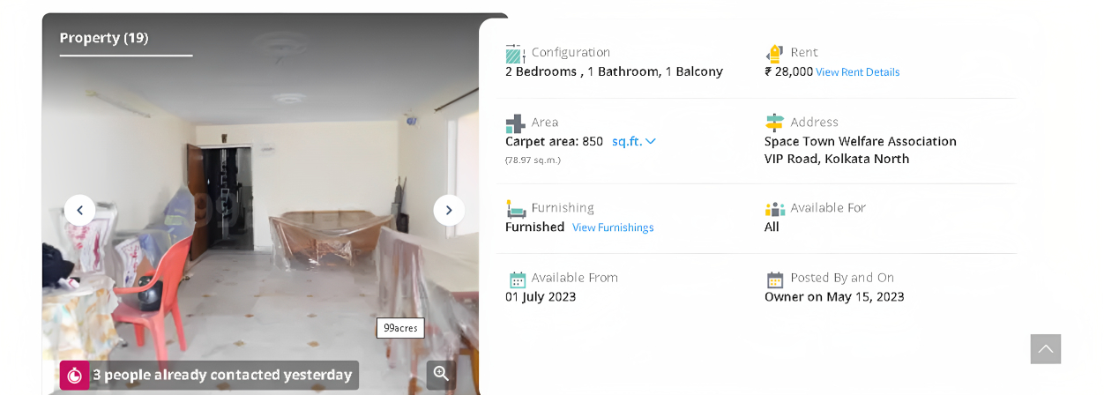
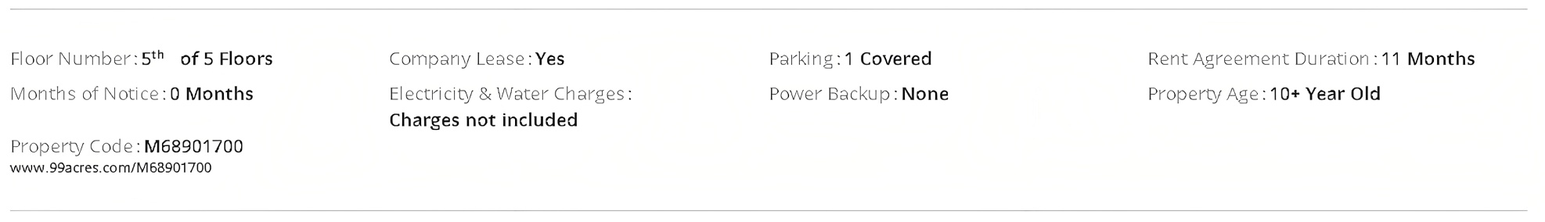
15

Slide 17
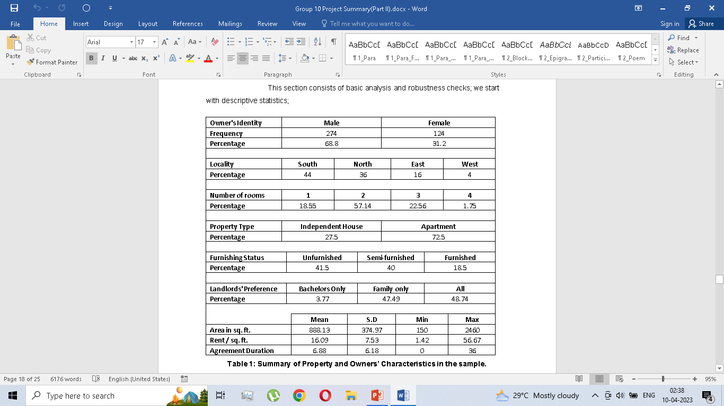
Summary of Property and Owners’ Characteristics in the sample.
Landlord’s identity
16

Slide 18
1(A) Who is more likely to get Rental Property: Male or Female?
Case 1: Callback
Chi squared Test for Callback and Applicants Gender.
 | Applicant's Gender
Callback | Male | Female | Total
No Response | 122 | 109 | 231
Response | 77 | 90 | 167
Total | 199 | 199 | 398
No Response
Response received
Response to MALE Applicant
The chi-square statistic is 1.7436. The p-value is 0.187. Not significant at p < .05.
The chi-square statistic with Yates correction is 1.4857. The p-value is 0.223. Not significant at p < .05
No statistical significant association b/w callback received and applicants gender. In other words, gender does not matter in getting callback.
Response received
No Response
Response to FEMALE Applicant
17

Slide 19
Case 2: Callback Frequency
 | N | Callback Count | Median Count | Mean Count | S.D | Min. Count | Max. Count
Male | 199 | 131 | 0 | 0.66 | 1.29 | 0 | 10
Female | 199 | 218 | 0 | 1.1 | 1.73 | 0 | 8
Summary statistics of callback frequency for the sample
The outcome variable here, ‘frequency’ does not follow normal distribution hence we make use of non-parametric tests
18

Slide 20
Callback Frequency: when positive response
We conduct a Two-sample Wilcoxon rank-sum (Mann-Whitney) test with Null Hypothesis:
Ho: frequency(applicant gender==1) = frequency(applicant gender==2)
Prob > |z| = 0.0013
p-value =0.0013 (< 0.05) ➔ statistically significant difference in the intensities of callback across gender.
Females get a higher mean response compared to males.
Differential treatment on the basis of gender identity exists- Callback frequency is higher in case of female tenants.
Mean of Frequency for Male and Female
19

Slide 21
1(B) Is the Landlord biased towards the same gender?
Case 1: Callback
State | N | Mean | SD | Min | Max
Matching | 201 | 0.8 | 1.32 | 0 | 8
Mismatching | 197 | 0.95 | 1.73 | 0 | 10
The chi-square statistic is 0.1138. The p-value is .735814. Not significant at p < .05.
The chi-square statistic with Yates correction is 0.0556. The p-value is .813569. Not significant at p < .05.
We fail to reject the null hypothesis. No statistical difference in callback when the landlord and the applicant share the same gender vs. when they do not
Summary Statistics for Match and mismatch cases
 | Gender Matching
Callback | Mismatch | Match | Total
No Response | 116 | 115 | 231
Response | 81 | 86 | 167
Total | 197 | 201 | 398
20

Slide 22
Case 2: Callback Frequency
We conduct a Two-sample Wilcoxon rank-sum (Mann-Whitney) test with null hypothesis:
Ho: frequency(gender_matching==0) = frequency(gender_matching==1)
Prob > |z| = 0.1896
p-value 0.1896 (> 0.05). We fail to reject the null hypothesis. No statistical significant association b/w frequency of callback received and case of gender matching of landlord and applicant.
Gender difference between the prospective tenant and the landlord does not affect both the possibility of callback and callback frequency. In other words, the Landlords do not seem to be biased towards the same gender.
21

Slide 23
2 (A) Can providing Monetary Incentive reduce the Gender gap?
Gender gap in Baseline (T0) and Monetary incentive (T1) Treatment
 | Male | Female | Gender gap
Callback in T0 | 17 | 23 | 6
Callback in T1 | 19 | 21 | 2
The chi-square statistic is 0.202. The p-value is 0.653095. Not significant at p < .05.
The chi-square statistic with Yates correction is 0.0505. The p-value is 0.822187. Not significant at p < .05.
Monetary incentive is reducing gender gap in callback compared to the baseline scenario but not statistically significantly.
22

Slide 24
2 (B) Can providing Educational Information reduce the Gender gap?
Gender gap in Baseline (T0) and Educational Information (T2) Treatment
 | Male | Female | Gender gap
Callback in T0 | 17 | 23 | 6
Callback in T2 | 22 | 25 | 3
The chi-square statistic is 0.8032. The p-value is 0.370146. Not significant at p < .05.
The chi-square statistic with Yates correction is 0.465. The p-value is 0.495308. Not significant at p < .05.
Educational information is reducing gender gap in callback compared to the baseline scenario but not statistically significantly.
23

Slide 25
2 (C) Can providing both monetary incentive and Educational info. reduce the Gender gap?
Gender gap in Baseline (T0) and Monetary incentive+ educational information(T3) Treatment
 | Male | Female | Gender gap
Callback in T0 | 17 | 23 | 6
Callback in T3 | 16 | 23 | 7
The chi-square statistic is 0.0176. The p-value is 0.894316. Not significant at p < .05.
The chi-square statistic with Yates correction is 0.0091. The p-value is 0.924075. Not significant at p < .05
Monetary incentive + Educational information increases gender gap in callback compared to the baseline scenario but not statistically significantly.
24

Slide 26
3. What are the factors affecting callback frequency? Are monetary incentive and/or Educational info. Important determinant of increasing callback frequency?
Data is not normally distributed with count outcome
Poisson Regression and negative binomial
Callback Frequency Histogram
25

Slide 27
The causal relationship between Callback frequency and the gender identity of applicant and other property characteristics can be specified as:
 |  | Baseline Model
Frequency |  | IRR | Std. Err. | P>|z|
Applicant's gender |  | 1.912 | 0.613 | 0.025
Property type |  | .996 | 0.282 | 0.934
Rent / sq. ft. |  | 1.06 | 0.01 | 0.000
Furnishing status | 2 | 0.526 | 0.1737 | 0.052
 | 3 | 0.445 | 0.197 | 0.068
Property age | 2 | 0.838 | 0.291 | 0.609
 | 3 | 0.681 | 0.255 | 0.304
1) Baseline Model:
Frequency= f(Applicants gender, Property Type, Rent per sq. ft., Furnishing status, Property Age)
Frequency=
Exp(β0 + β1*Applicants gender +
β2*Property Type +
β3* Rent per sq. ft.+
β4*Furnishing status +
β5* Property Age+ ε0)
Number of obs. = 98
LR chi2(7) = 43.85
Prob > chi2 = 0.0000
Pseudo R2 = 0.1924
Deviance goodness-of-fit = 94.39783
Prob > chi2(90) = 0.3549
Pearson goodness-of-fit = 96.64436
Prob > chi2(90) = 0.2970
26

Slide 28
Frequency
Applicant's gender
Property type
Rent / sq. ft.
Furnishing status | 2
 | 3
Property age | 2
 | 3
Treatment | 2
 | 3
 | 4
Full Model
IRR | Std. Err. | P>|z|
1.727 | 0.186 | 0.001
1.171 | 0.154 | 0.423
1.019 | 0.0073 | 0.092
0.743 | 0.142 | 0.121
1.124 | 0.258 | 0.611
1.318 | 0.254 | 0.152
0.836 | 0.189 | 0.427
1.752 | 0.431 | 0.022
1.668 | 0.415 | 0.040
1.368 | 0.337 | 0.204
2) Full Model:
Frequency= f(Applicants gender, Property Type, Rent per sq. ft., Furnishing status, Property Age, Treatments)
Frequency=
Exp(β0 + β1*Applicants gender +
β2*Property Type +
β3* Rent per sq. ft.+
β4*Furnishing status +
β5* Property Age +
β6*Treatment +ε0)
Number of obs. = 398
LR chi2(10) = 27.19
Prob > chi2 = 0.0024
Pseudo R2 = 0.0267
Likelihood-ratio test of alpha=0:
chibar2(01) = 144.78
Prob>=chibar2 = 0.000
27

Slide 29
Limitation
We did not directly indicate gender, but signalled them through the names that we had created for our testers. There is a possibility that some landlords may not have noticed the names that was used as our signal.
The anonymity granted by the Internet means that landlords could have advertised vacant apartments or have artificial identities.
Since the pool of buyers for any landlord is unknown to us, we cannot explicitly claim that a landlords response is completely guided by our signal.
Offline property hunts through - newspaper ads and social networks were not considered due to the appearance bias . This exclusion could have qualitatively influenced our results.
28

Slide 30
Conclusion
Our project employs a signaling strategy to provide evidence on how landlord treatment of rental housing applicants varies for different gender.
Name, Monetary incentive, Educational information are used to convey the characteristic of applicants through a randomized correspondence audit design.
Findings suggest a somewhat differential treatment to different genders.
In all the studies we have reviewed so far the sellers perspective was silent. We partially answered it by involving sellers identity through matching and mismatching. Here, no in-group favoritism/out-group derogation- as the landlord may assume by default that a tenant will live with his/her family.
Monetary incentive and Educational information affects the frequency of calls received per applicant.
Applicants’ gender and rent per sq. ft. are robust factors that affect the chances of getting higher frequency of calls from a landlord.
Moving forward, future research on post-experiment survey can be done to understand the sellers mind.
29

Slide 31
Thank You

